Slide 1
Man
Article III of The Baptist
Faith & Message 2000

Slide 2
“Man is the special creation of God, made in His own image. He created them male and female as the crowning work of His creation. The gift of gender is thus part of the goodness of God's creation. In the beginning man was innocent of sin and was endowed by his Creator with freedom of choice. By his free choice man sinned against God and brought sin into the human race. Through the temptation of Satan man transgressed the command of God, and fell from his original innocence whereby his posterity inherit a nature and an environment inclined toward sin. Therefore, as soon as they are capable of moral action, they become transgressors and are under condemnation. Only the grace of God can bring man into His holy fellowship and enable man to fulfill the creative purpose of God. The sacredness of human personality is evident in that God created man in His own image, and in that Christ died for man; therefore, every person of every race possesses full dignity and is worthy of respect and Christian love.”

Slide 3
The Image of God
The exact meaning of the Image of God is not explained in Scripture or the BF&M!
Some theories:
1.) Man alone is endowed with the ability to reason and make moral decisions
2.) Man alone is capable of entering a relationship with God
3.) Man alone has a unique command in the Earth—to be fruitful and multiply, and to reign over animals.

Slide 4
The Image of God (cont.)
It seems as though each of these theories have some explanatory power concerning the Image of God.
Nevertheless, we can all agree that because every single human is made in the Image of God, every single human has unique dignity apart from the rest of God’s creation.
Because of this, we recognize that all humans, whatever race or gender, are worthy of equal respect and Christian love.

Slide 5
Gender
“the gift of gender is thus part of the goodness of God’s creation”
God’s creative purpose was to give different roles to male and female.
They could not accomplish God’s command to fill the Earth alone—they need one another.
Gender and gender roles are not cultural constructs—it is rooted in the creative order itself.

Slide 6
The Fall of Man
God created man without sin and with freedom of choice
By this choice, because of temptation…
Sin enters the world
Sin enters Adam and Eve
“whereby his posterity inherit a nature… inclined toward sin.”
“Therefore, just as sin entered the world through one man, and death through sin, in this way death spread to all people, because all sinned.” Romans 5:12

Slide 7
Salvation
Article 4 of the
Baptist Faith & Message 2000

Slide 8
Salvation involves the redemption of the whole man, and is offered freely to all who accept Jesus Christ as Lord and Saviour, who by His own blood obtained eternal redemption for the believer. In its broadest sense salvation includes regeneration, justification, sanctification, and glorification. There is no salvation apart from personal faith in Jesus Christ as Lord.

Slide 9
How can one be saved?
Christians have answered this question differently.
Standpoint | Who will be saved?
Exclusivism | Those who put conscious faith in Jesus Christ.
Inclusivism | Those who seek out God through religion.
Universalism | Everyone.

Slide 10
The four “-tion”s in the BF&M: IV
Regeneration, Justification, Sanctification, Glorification
Each of these terms describes different facets and “steps” of salvation.
None of these can be skipped and rely upon one another.

Slide 11
Salvation
Article 4 of the
Baptist Faith & Message 2000

Slide 12
Regeneration
“Regeneration, or the new birth, is a work of God's grace whereby believers become new creatures in Christ Jesus. It is a change of heart wrought by the Holy Spirit through conviction of sin, to which the sinner responds in repentance toward God and faith in the Lord Jesus Christ. Repentance and faith are inseparable experiences of grace.
Repentance is a genuine turning from sin toward God. Faith is the acceptance of Jesus Christ and commitment of the entire personality to Him as Lord and Saviour.”

Slide 13
Regeneration (cont.)
John 3:1-8 The new birth explained to Nicodemus
“Therefore, if anyone is in Christ, he is a new creation. The old has passed away; behold, the new has come.” 2 Corinthians 5:17
“And I will give you a new heart, and a new spirit I will put within you. And I will remove the heart of stone from your flesh and give you a heart of flesh.” Ezekiel 36:26

Slide 14
Justification
“Justification is God's gracious and full acquittal upon principles of His righteousness of all sinners who repent and believe in Christ. Justification brings the believer unto a relationship of peace and favor with God.”
Justification is a legal term. It is much like what we hear in courts with the pronouncement, “not guilty.”
The Greek term literally means “to declare righteous.”

Slide 15
Justification (cont.)
Baptists believe in Sola Fide—Faith Alone
Justification is not earned through works of our own. It is by grace through faith in Christ that we are justified before God.
“For it is by grace you have been saved, through faith—and this is not of your own doing, it is the gift of God—not a result of works, that no one may boast.” Ephesians 2:8-9

Slide 16
Sanctification
“Sanctification is the experience, beginning in regeneration, by which the believer is set apart to God's purposes, and is enabled to progress toward moral and spiritual maturity through the presence and power of the Holy Spirit dwelling in him. Growth in grace should continue throughout the regenerate person's life.”
Sanctification is the in-between of justified and glorified.
The word “sanctification” comes directly from the word “holy” or “set apart.”

Slide 17
Sanctification (cont.)
Sanctification is primarily referred to as the stage in-between Justification (beginning of salvation) and Glorification (consummation of salvation).
Spiritual growth
Process of becoming holy
The mortification of sin
“Work out your own salvation with fear and trembling, for it is God who works in you, both to will and to work for His good pleasure.” Philippians 2:14
We ARE sanctified, we are BEING sanctified, and we WILL BE sanctified.

Slide 18
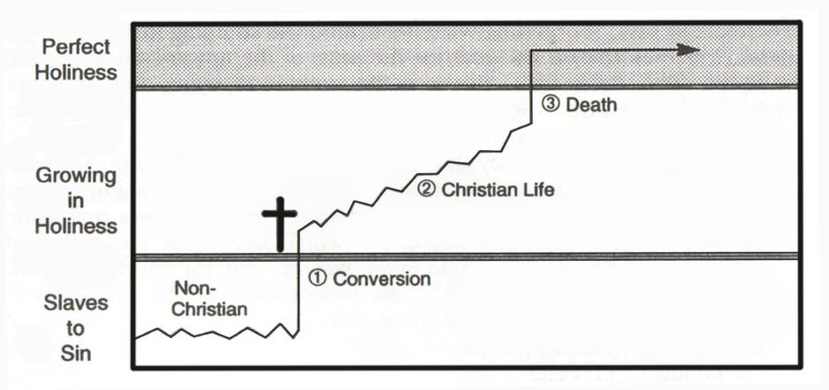
Sanctification (cont.)

Slide 19
Glorification
“Glorification is the culmination of salvation and is the final blessed and abiding state of the redeemed.”
At the end of time, by the Resurrection, we will receive new bodies free from the scars of sin.
The sin that has been inseparable from our human experience will be no more—we will experience and abide in pure holiness and be in perfect communion with God forever.

Slide 20
God’s Purpose of Grace
Article V of the
Baptist Faith & Message 2000

Slide 21
“Election is the gracious purpose of God, according to which He regenerates, justifies, sanctifies, and glorifies sinners. It is consistent with the free agency of man, and comprehends all the means in connection with the end. It is the glorious display of God's sovereign goodness, and is infinitely wise, holy, and unchangeable. It excludes boasting and promotes humility.”

Slide 22
What is Election?
“Election is the gracious purpose of God, according to which He regenerates, justifies, sanctifies, and glorifies sinners.”
While the topic of Divine Election is not as commonly found in Scripture as other doctrines, it is explicitly taught throughout the Old and New Testaments.
Baptists believe in Divine Election because the Bible teaches it.

Slide 23
Romans 8:28-30 (ESV)
“²⁸And we know that for those who love God all things work together for good, for those who are called according to his purpose. ²⁹For those whom he foreknew he also predestined to be conformed to the image of his Son, in order that he might be the firstborn among many brothers. ³⁰And those whom he predestined he also called, and those whom he called he also justified, and those whom he justified he also glorified.”

Slide 24
Election (cont.)
There are three Greek verbs we are looking out for when considering God’s purpose of grace.
Foreknew
(proginosko – Literally “before” + “to know”)
Predestined
(proorizo – Literally “before” + “to define/decide”)
Chose/Elected
(eklegomī – Literally “out of” + “to speak/declare”)

Slide 25
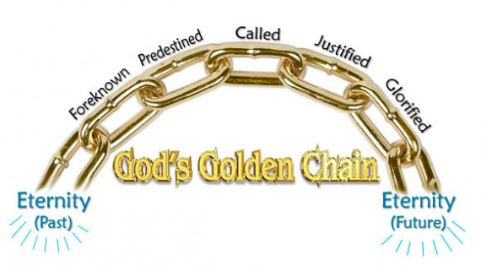
The Golden Chain (Rom. 8:29-30)

Slide 26
Election (cont.)
Conclusions on Romans 8:28-30:
All those who God foreknows are predestined to salvation.
Therefore predestination, and specifically election, concerns peoples’ salvation.
If God elects somebody, that person will be saved (glorification) and cannot “fall away from grace.”
However, since not everybody will be saved, not everybody is predestined or elected (chosen) by God.

Slide 27
Ephesians 1:3-6
³Blessed be the God and Father of our Lord Jesus Christ, who has blessed us in Christ with every spiritual blessing in the heavenly places, ⁴even as he chose us in him before the foundation of the world, that we should be holy and blameless before him. In love ⁵he predestined us for adoption to himself as sons through Jesus Christ, according to the purpose of his will, ⁶to the praise of his glorious grace, with which he has blessed us in the Beloved.

Slide 28
Election (cont.)
“…even as he chose us in Him…”
Eklegomi – to choose, elect, decide
“…before the foundation of the world…”
Before (pro) anyone or anything existed, God’s choosing was complete.
“In love he predestined us for adoption as sons…”
Proorizo
He did not just predestine. He predestined to adoption. Adoption is an important part of the Gospel.

Slide 29
Election (cont.)
Some conclusions from Ephesians 1:3-6
God elected his saints before any of them were born.
God’s election concerns who will be adopted.
God’s election is based on His plan, which humans do not know. We cannot say that anybody is elect or not elect to salvation.
Conclusion: God’s election concerns the salvation of those who He elects.

Slide 30
Free will
“It is consistent with the free agency of man, and comprehends all the means in connection with the end.”
Though God elects, we still have to chose God.
Though God elects, we still are responsible for our decisions.
Though God elects, we still evangelize.

Slide 31
The Tension
Balance
Hard Determinism
Fatalism
Open Theism
Free Will
Election
God does not foreknow the actions of free humans, and He does not predestine them.
Whoever God elects, God saves, therefore we don’t need to evangelize.

Slide 32
“A Glorious Display”
“It is the glorious display of God's sovereign goodness, and is infinitely wise, holy, and unchangeable. It excludes boasting and promotes humility.”
The point:
God is a sovereign, holy, and wise God.
His election shows us how truly rich His grace is.
Our possession of free will shows us that we must choose to obey God and are responsible for not doing so.

Slide 33
“All true believers endure to the end. Those whom God has accepted in Christ, and sanctified by His Spirit, will never fall away from the state of grace, but shall persevere to the end. Believers may fall into sin through neglect and temptation, whereby they grieve the Spirit, impair their graces and comforts, and bring reproach on the cause of Christ and temporal judgments on themselves; yet they shall be kept by the power of God through faith unto salvation.”

Slide 34
God’s Preservation
“Once Saved, Always Saved”
If you are ever saved, you will always be saved.
“Eternal Security”
The salvation of those who are saved is secure in God’s hands.
“Perseverance of the Saints”
“…yet they shall be kept by the power of God through faith unto salvation.”
All of these terms are absolutely true and agree with each other.

Slide 35
God’s Preservation (cont.)
What about those who made a profession of faith in Christ and later rejected Him?
“because, if you confess with your mouth that Jesus is Lord and believe in your heart that God raised him from the dead, you will be saved. ¹⁰For with the heart one believes and is justified, and with the mouth one confesses and is saved.” Romans 10:9-10
There will be those who confess with their mouth but do not believe with their heart.

Slide 36
God’s Preservation (cont.)
“But the one who endures to the end will be saved.” Matt. 23:14
Also see Col. 1:22-23; 1 Cor. 15:1-2
This is not a prescription, (i.e., you have to endure to be saved), but a description of a truly saved person.
A truly saved person will endure until the end because it is God’s will, by His power, to sustain him or her.

Slide 37
Additional Scripture References
Matt. 11:25-30; 23:37; 24:22, 24, 31
John 3:16-17; 6:22-51; 8:13-16, 39-47; 10:1-5, 14-16, 25-30; 12:37-40; 15:16, 19; 17:6-26
Acts 2:23; 4:27-29; 13:48;
Rom. 8:7-8; 9:6-29
1 Ti. 2:1-4
1 Pe. 1:1-2
1 John 2:29; 5:1
Isa. 10:5-7; 37:26
Prov. 16:4; 21:1
Gen. 50:20

